Slide 1
Project 2 Presentation
MATH4753
Spring 2025
Dr. Wayne Stewart
Tiffany Nguyen

Slide 2
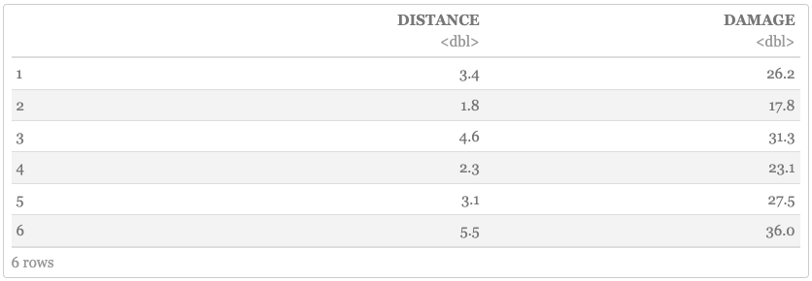
The Data
MATH4753
04/30/2025
(x)
(y)
A tibble of the FIREDAM.csv data
Notes:
So this is the firedam.csv dataset provided by our textbook Statistics for Engineering and the Sciences (6th Edition). Here you can see I have taken a small sample of the data to give you an idea of what this dataset might look like. The first variable is x, the distance in miles between the fire and the nearest fire station, and the second variable is y, the amount of damage in thousands of dollars. This study was conducted in a large suburb of a major city and a sample of 15 recent fires have been selected for this research.

Slide 3
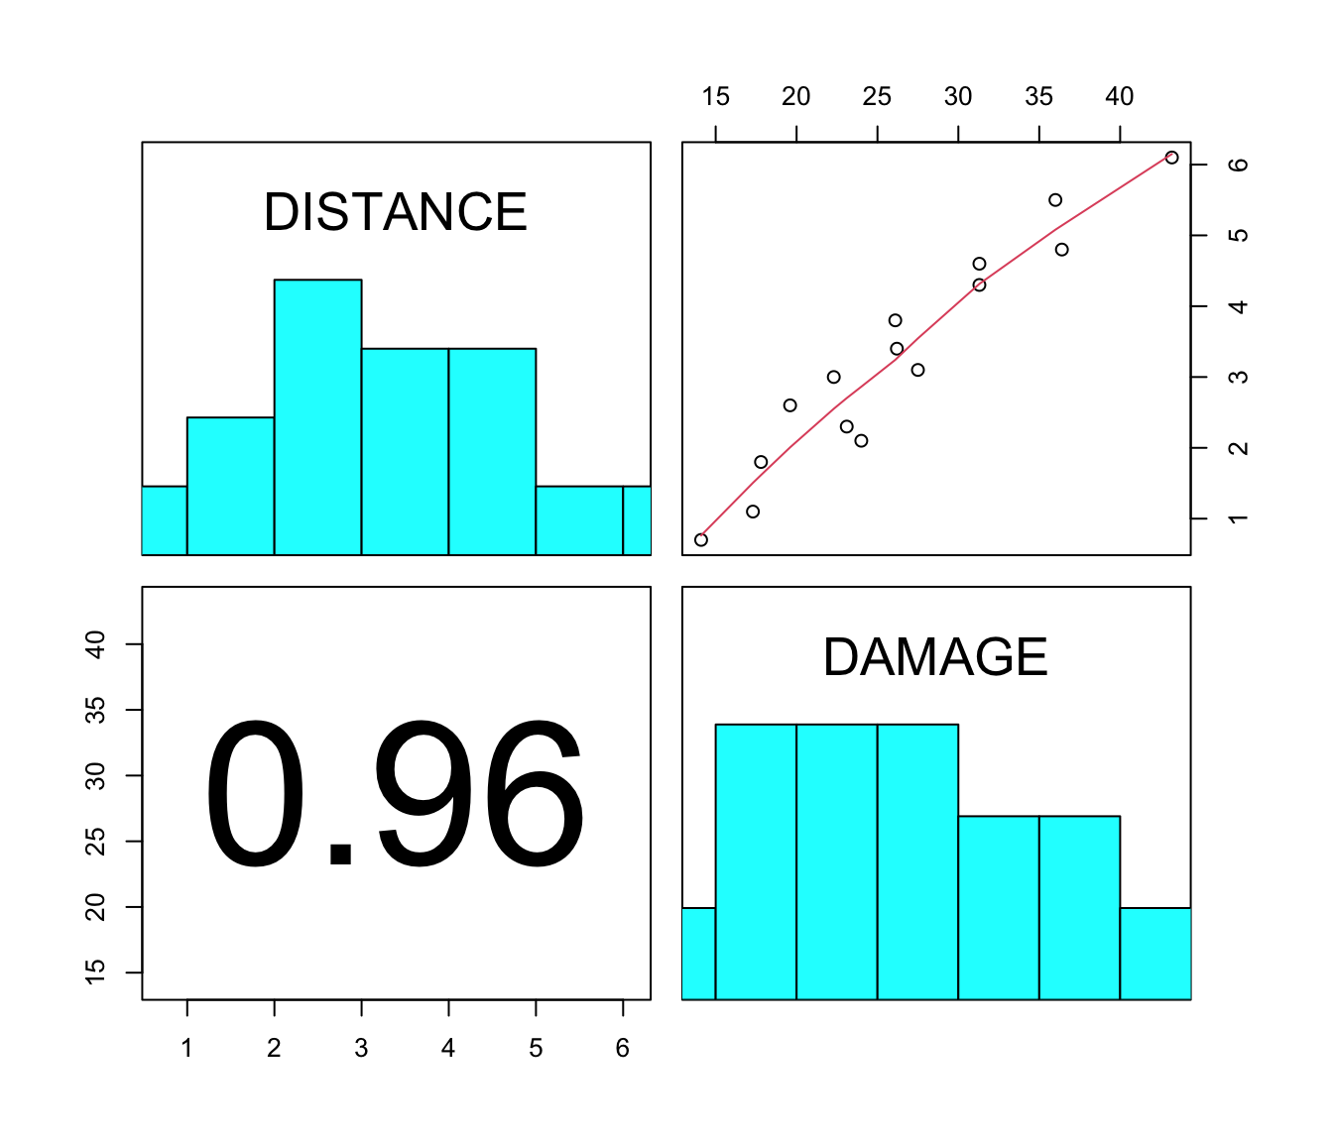
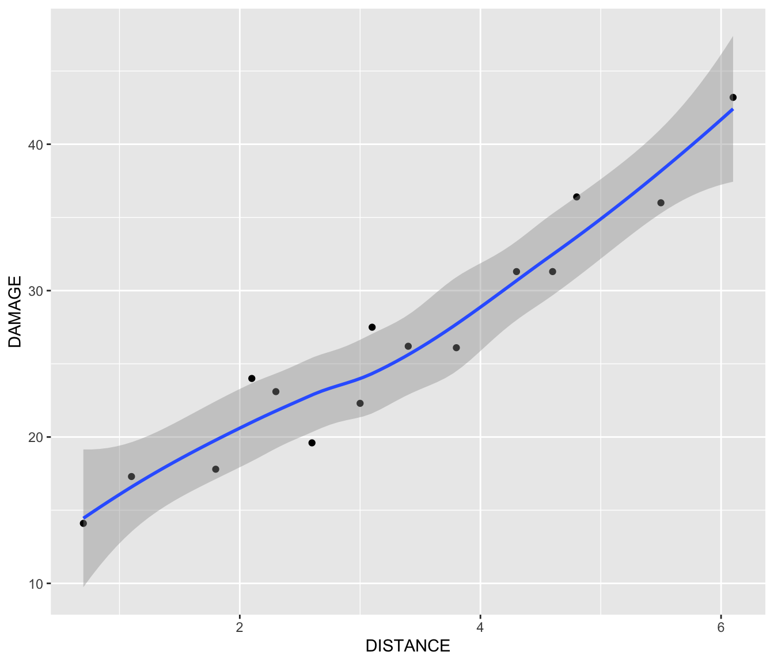
The Problem
MATH4753
04/30/2025
Is there a relationship?
Notes:
In this research I am primarily analyzing the data to determine what, if any, statistical relationship exists between the fire station distance and the fire damage cost in major residential fires. Success of this project will be determined by how accurate the model is. Here in the slides, I have done some preliminary plots and interpretations of the data to get sort of an idea on how the data looks. Here on the left you can see the distribution of x and y and its potential correlation with each other. Here on the right you can get sort of the same idea but presented in a nicer way. At first glance this data does seem to be somewhat uniform and linear, but for statistics sake (and accuracy) a statistical analysis will determine the degree to which this is true.

Slide 4
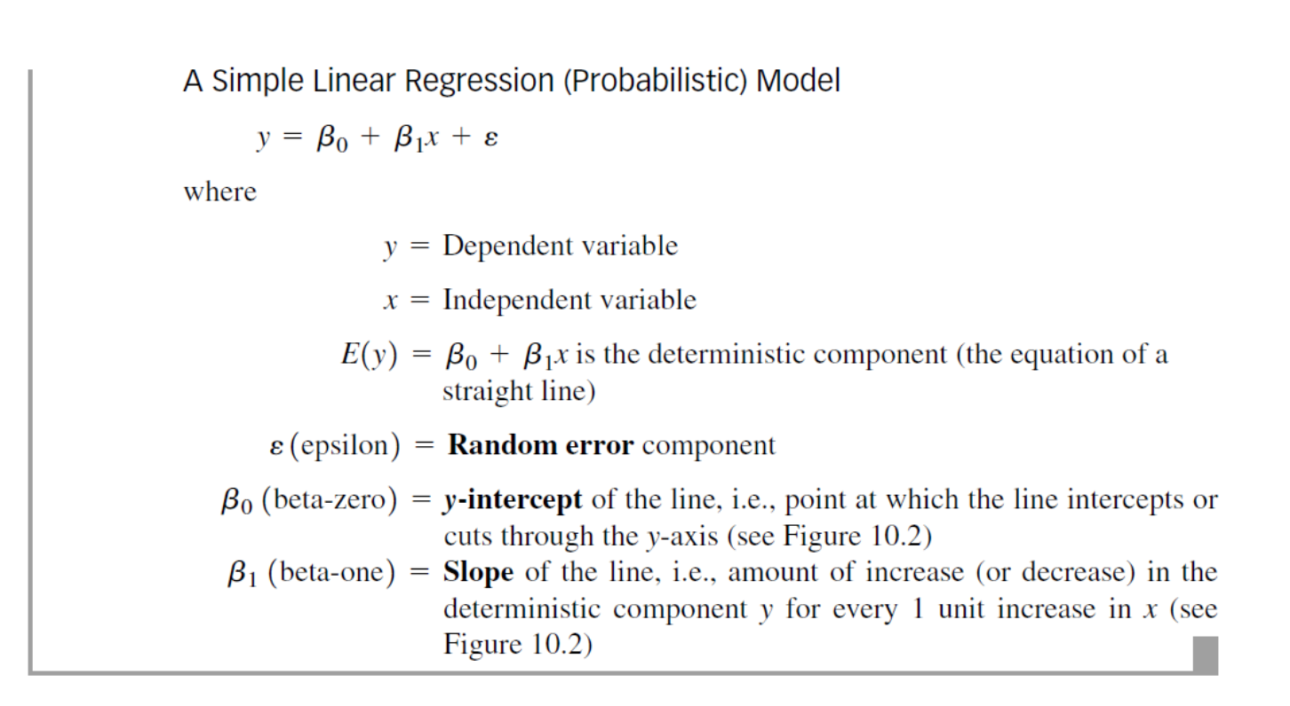


Background Theory Analysis
MATH4753
04/30/2025
Simple linear regression model
Mean value of y
Notes:
First we will start with background on some theory for analyzing this data. Again our goal is to model the relationship between the distance from the fire station (x) and the damage in thousands of dollars (y). I predict that the variables have a linear relationship, and that as distance increases, the damage will tend to increase. For this case we will use the simple linear regression model, shown on the upper left. Here we have beta knot as the y-intercept, beta 1 as the slope, and epsilon as the error component. Next, we will assume the average errors will be 0 for the sake of linear regression. This gives us the second equation where error will trend out to 0. Thus for the mean value of y for any given value of x, this average will graph as a straight line.

Slide 5

Assumptions about 𝜖
MATH4753
04/30/2025
1
2
3
4
𝜖 = 0
Var(𝜖) = σ²
𝜖 has a normal distribution
𝜖’s are independent
The mean of the probability is 𝜖 = 0
The variance of the probability distribution of 𝜖 is constant for all values of the independent variable. In the case of a straight-line model, variance is constant for all values of x
The distribution of 𝜖 is normal
The error component associated with observations are independent of one another
Notes:
To fit a simple linear regression model to a given dataset, its necessary for us to estimate the beta knot and beta 1 values. The validity of these estimates depend on the sampling distributions of the estimators, which are then influenced by the probability distribution of epsilon. Therefore we must make these assumptions about epsilon. [read from slides]

Slide 6

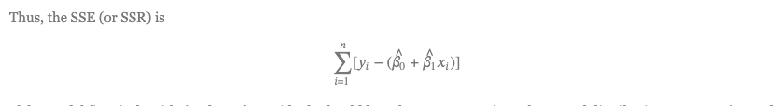
Estimating Parameters
MATH4753
04/30/2025
How to calculate residuals:
Notes:
To estimate beta knot and beta 1 we will use method of least squares to determine the line the best fits the data points with a minimum sum of squares of the deviations (also known as sum of squares for error or SSE. In our statistics class, this is the same thing as SSR). We will calculate residuals by getting the difference between the actual and the predicted values. The last image is just a nice way of formatting the residual calculations. If the model fits nicely with the data, then the residuals should have an approximately normal distribution with a mean of 0 and a constant variance. We will hypothesize a linear model for the dataset.

Slide 7
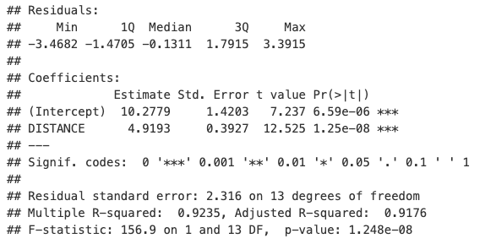


Least Squares Method, CI, Least Square Estimates
MATH4753
04/30/2025
Linear model equation using estimates
Notes:
Here we run some the summary r code to get pretty results. In the left image we can see the estimates for beta knot as 10.2779 and beta 1 as 4.9193. Then we calculate the confidence intervals to determine whether or not these estimates are reliable, and yes it seems they are. Then using these estimates we create a linear model equation, shown at the bottom.

Slide 8
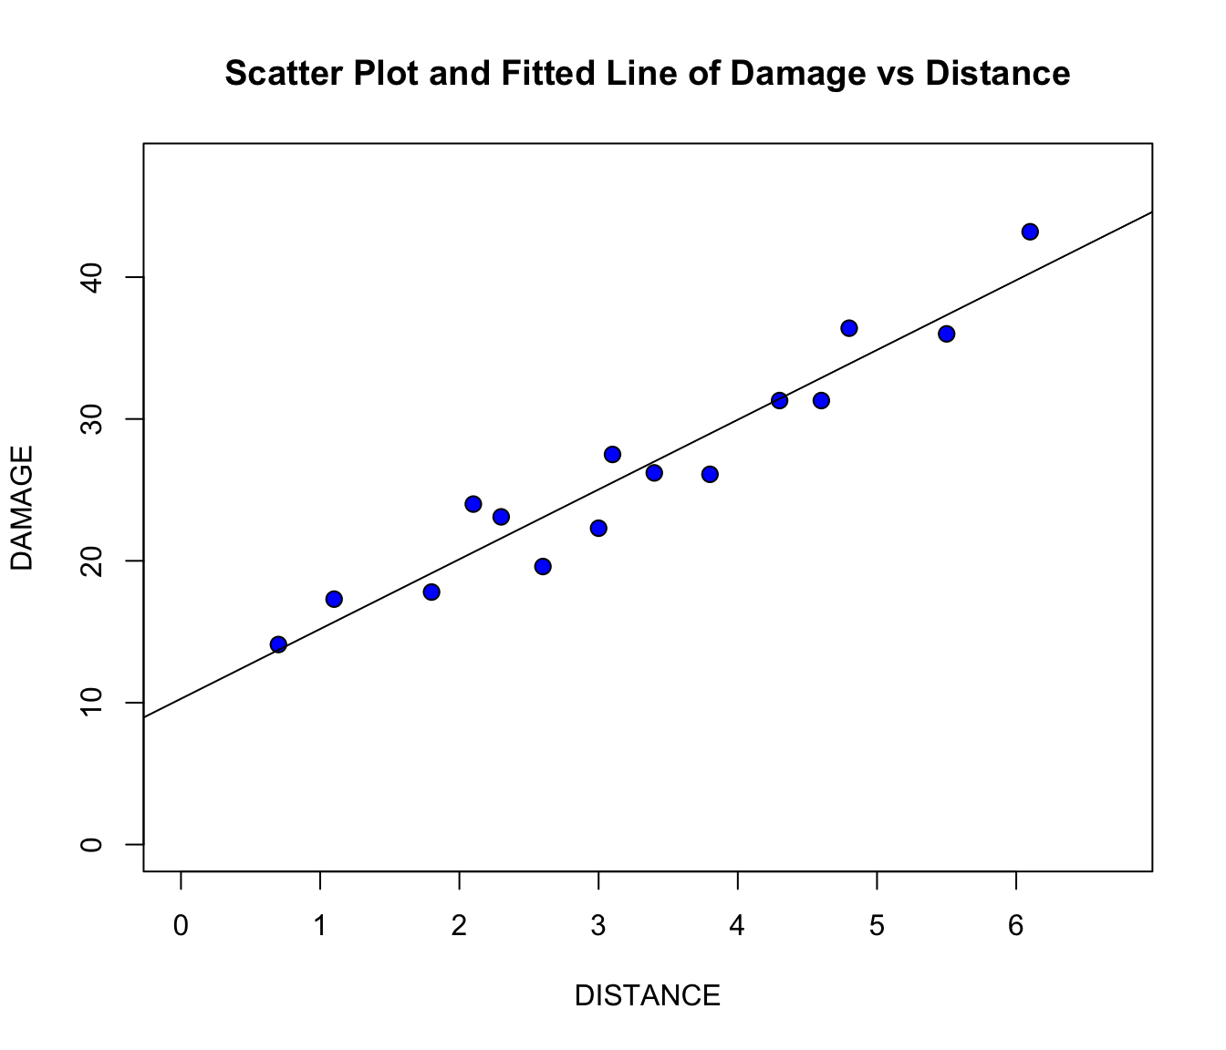
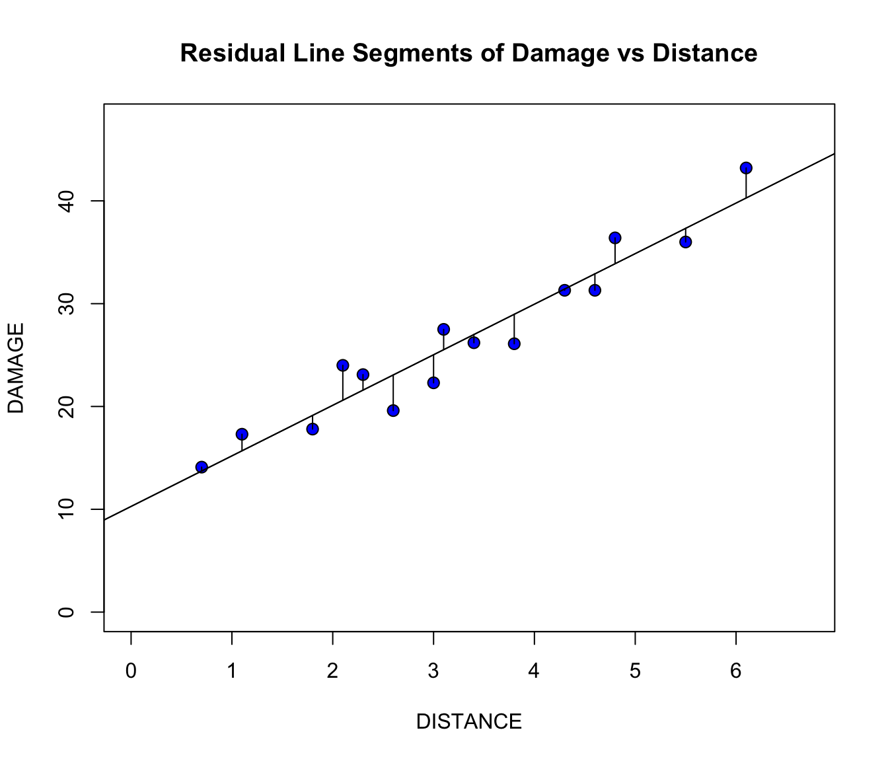
Validity with Plots
MATH4753
04/30/2025
Straight trend line
Plot of residuals
Notes:
Now I want to demonstrate that a straight line is (hypothetically) the best fit for the data gathered using visuals. On the left we have a simple scatter plot which seems to indicate that a straight line is a good fit for the data. Here on the right, we plotted the residual line segments which are the deviations about the fitted line. This allows us to visualize the extent to which the points vary from the line we are trying to fit to the data. As we can kind of see, the residuals seem somewhat evenly distributed and small. This also provides us with the Residual Sum of Squares which we will use to later on calculate the R-squared value.

Slide 9
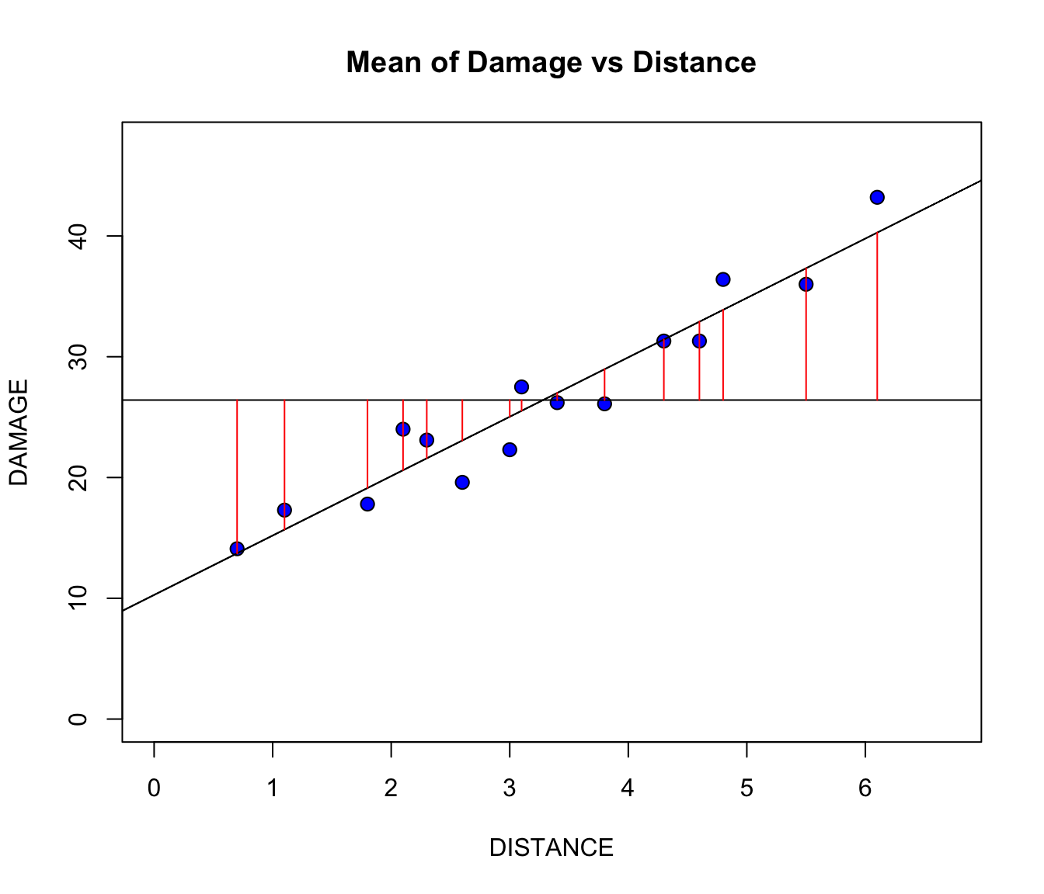
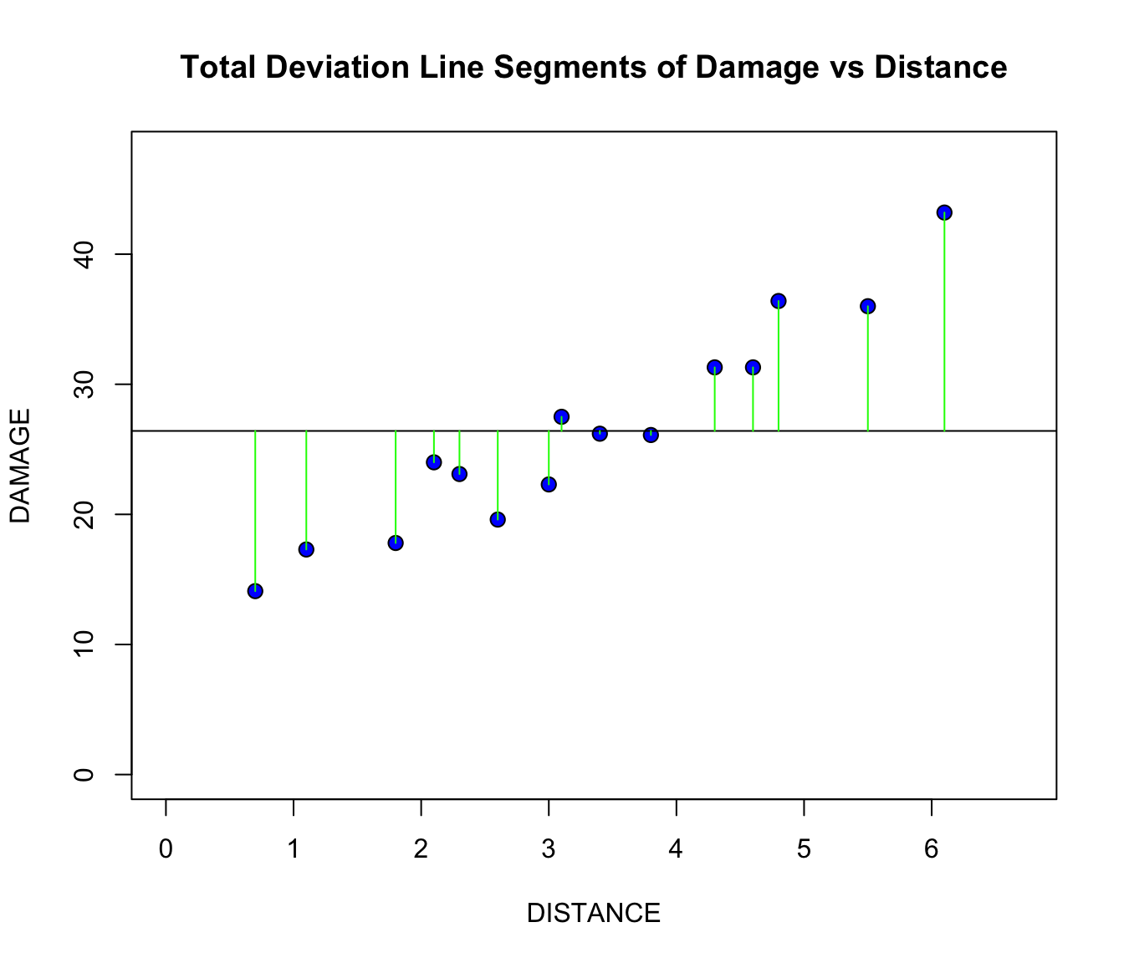
Validity with Plots
MATH4753
04/30/2025
Plot of means
Plot of means with total deviation
Notes:
Here on the left side we have the plot of means, which we can use to visualize the difference between the means of damage data and distance data. And here on the right side we have the same mean graph but with deviations of fitted line (providing us the total sum of squares). This graph is the same in concept, but helps demonstrate that y hat and y bar are equal. In other words, the model will accurately predict the mean.

Slide 10
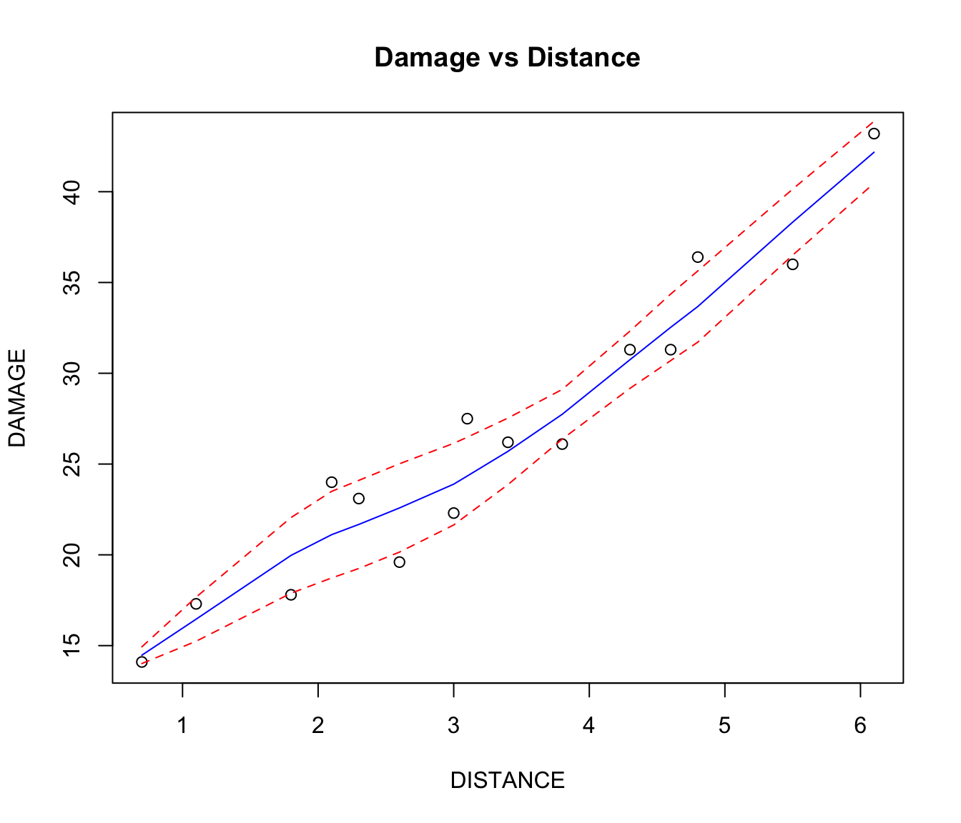
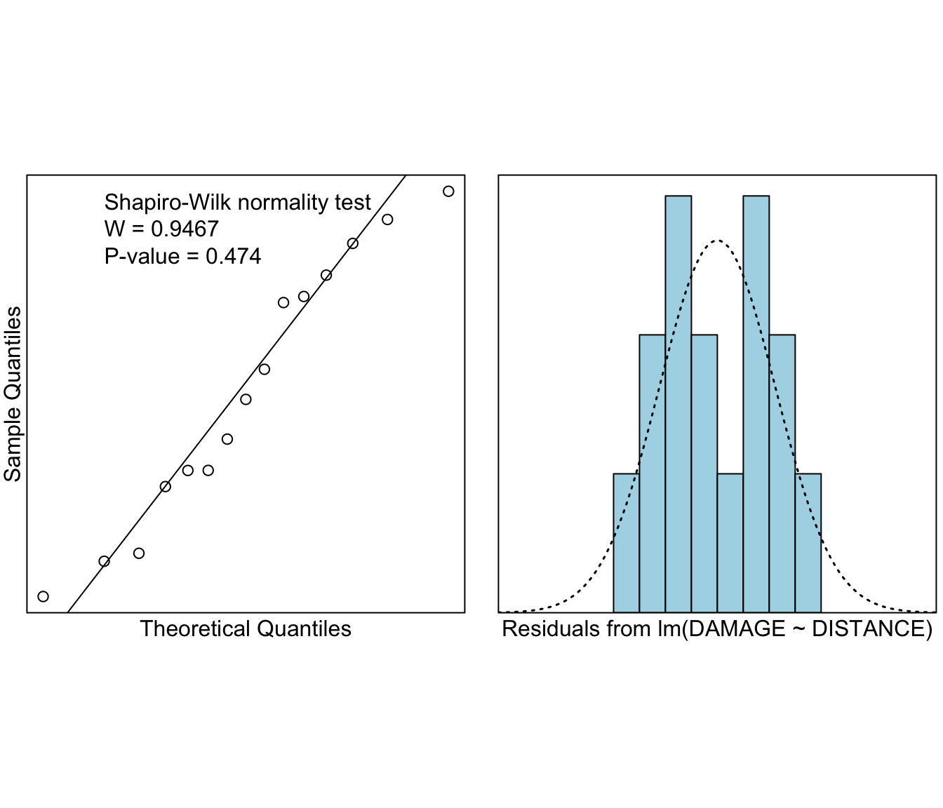
R-Squared, Trendscatter, Normality
MATH4753
04/30/2025
RSS = 69.75098
MSS = 841.7664
TSS = 911.5173
MSS/TSS = 0.92347
(This is also known as R-squared)
Shapiro-Wilk Test
Smooth scatter plot with region of error
ERRORS ARE NORMALLY DISTRIBUTED!
Notes:
Here we calculated RSS, MSS, TSS, and MSS/TSS, which is the R-squared. This R-squared value is also the value of the trend line. The closer R-squared is to 1, the better the trend line fits. To the left we have a trendsetter plot of damage vs distance. The red lines indicate the region of error where the best line of fit can potentially be found. In this plot we see a generally linear trend with a small region of error. To the right, we conducted a normality check, also known as the Shapiro-Wilk Test. From the normality test we found the p=value to be 0.474 which is greater than 0.05. This indicates that we do not have enough evidence to reject the null hypothesis and that the errors are therefore normally distributed. This is 1 of 4 of the assumptions of SLR.

Slide 11
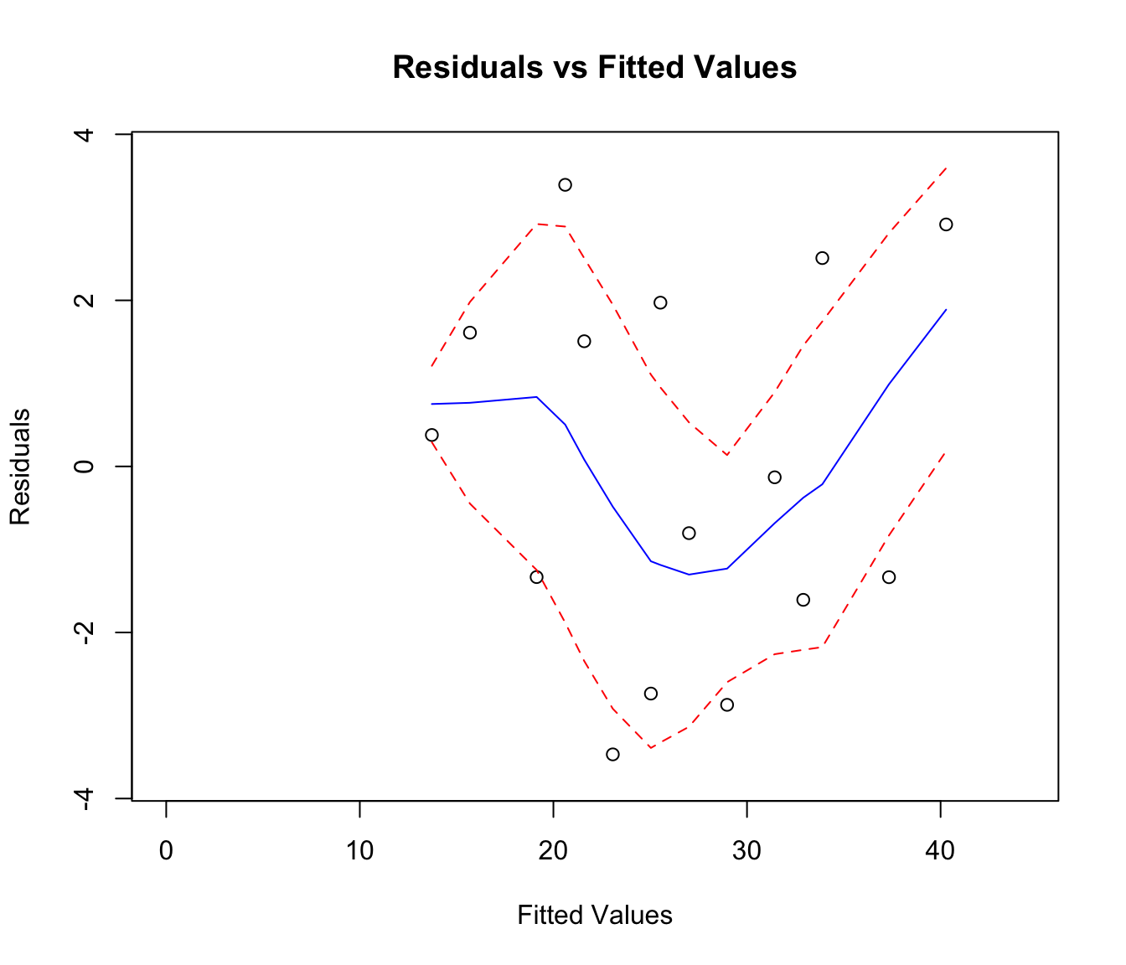
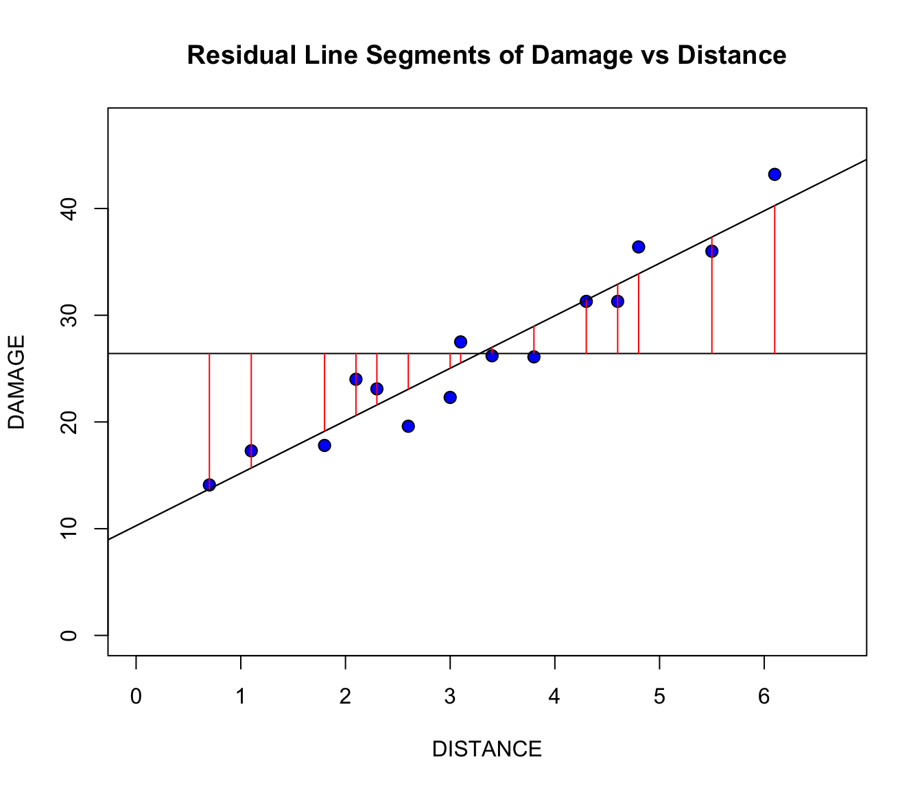
Residual and Fitted Values
MATH4753
04/30/2025
Uniformity is a bit uncertain but given the small sample size, this trend around 0 may signal a relationship, which supports the idea of a linear model
trendscatter on residual vs fitted values
These plots again
Notes:
Here we are quickly looking over the residual plots once again, and performing trendscatter on the residual vs fitted lines. This allows us to see if there is some kind of uniformity. Given this plot, uniformity seems a bit uncertain but given the small sample size, the trend around 0 can signal a linear model relationship.

Slide 12
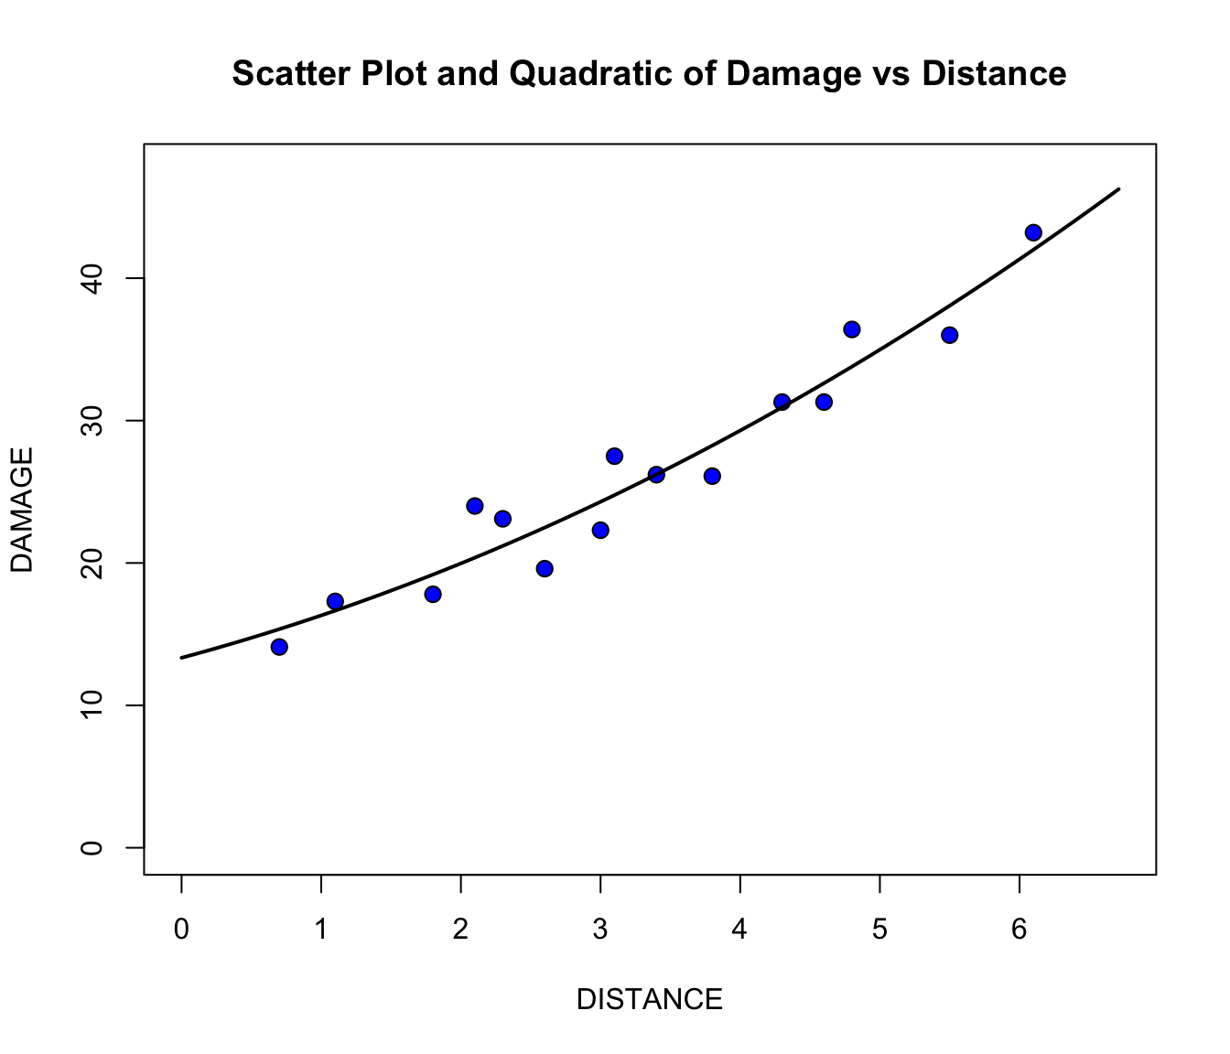
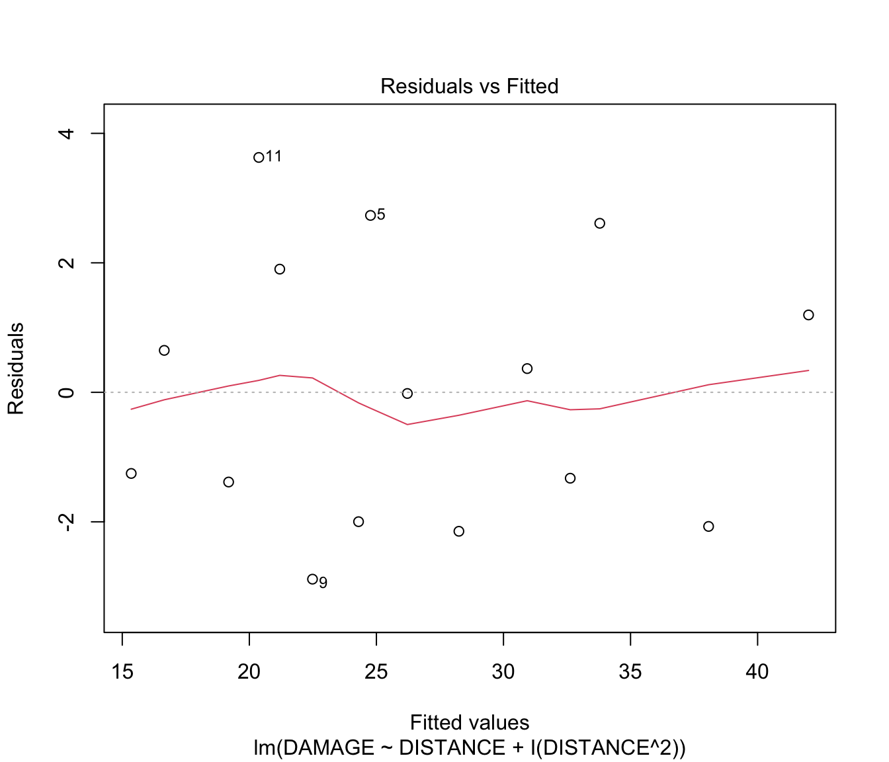
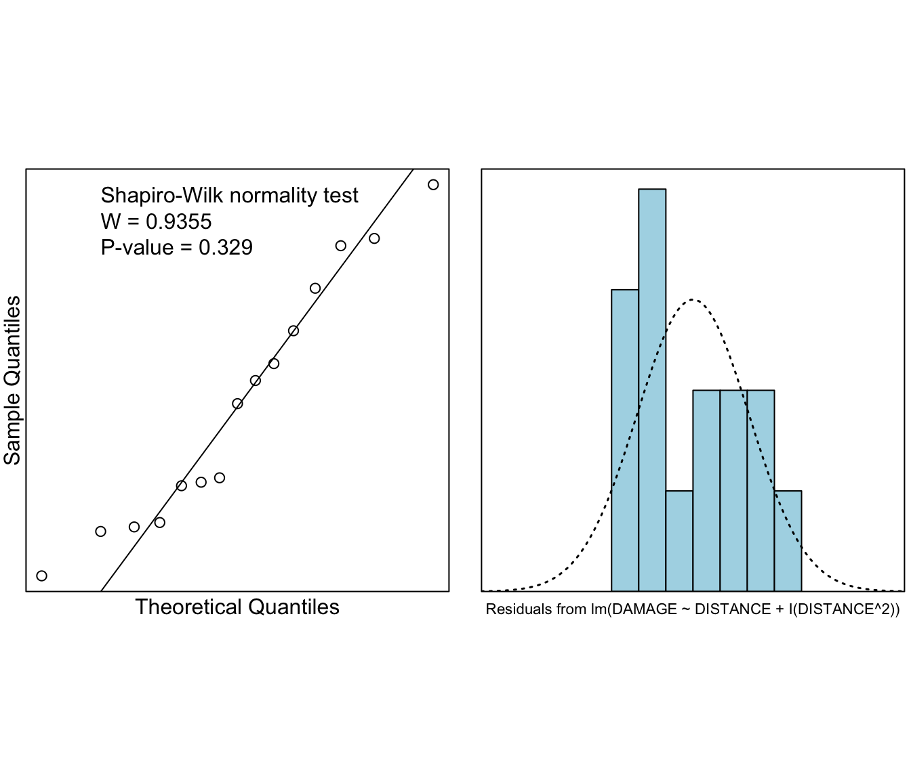
Model Comparison
MATH4753
04/30/2025
Quadratic scatter plot
Residuals vs fitted values
Shapiro-Wilks test
Notes:
Next we will compare the linear model with the quadratic model just for fun. On the left we have the quadratic scatter plot, which, initial impression is it does not produce a visibility dissimilar result although it does look somewhat fitting. Further analysis will help determine how well the quadratic will fit. The middle plot is the residuals vs fitted values, which seems to have a symmetry about the 0 y-axis value. We continue to have a linear trend displayed even when the quadratic model is applied. Lastly we have the shapiro-wilks normality test, giving us the p-value of 0.329 meaning we do not have enough evidence to reject the null hypothesis. The data seems to be distributed normally.

Slide 13
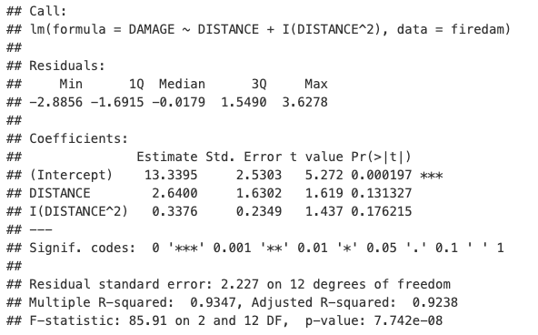




Model Comparison
MATH4753
04/30/2025
Confidence interval for estimates
Fitted line equation
Estimated beta values
Notes:
Now we will determine how well the quadratic model fits using estimates. Here we call a quick summary for the quadratic and we can see that beta knot is 13.3395, beta 1 is 2.6400, and beta 2 is 0.3376. Again we calculate the confidence interval just to double check the quality of the estimates, and then we come up with a fitted line equation again.

Slide 14
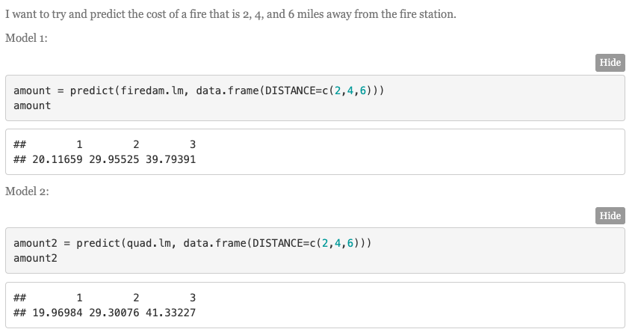
Model Comparison
MATH4753
04/30/2025
Predicting using each model
Notes:
Now we make predictions using both linear and quadratic models to see how they hold up. The predictions made using the linear model seem to be slightly larger than the predictions made using the quadratic model, but they are close to one another. More comparisons must be made to determine the best fit. Next, we compare the multiple R-squared and adjusted R-squared. We see that the multiple R-squared is 0.9235 and adjusted R-squared is 0.9176 for the linear model, and 0.9347 and 0.9238 for the quadratic model. I didn’t expect this. It seems purely from the R-squared values that the quadratic model is best fit compared to the linear model. The quadratic R-squared values are closer to 1 compared to the linear. Though the difference is barely 0.01, meaning the linear model is still a good fit despite not being the best fit.

Slide 15
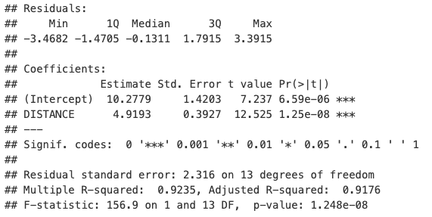
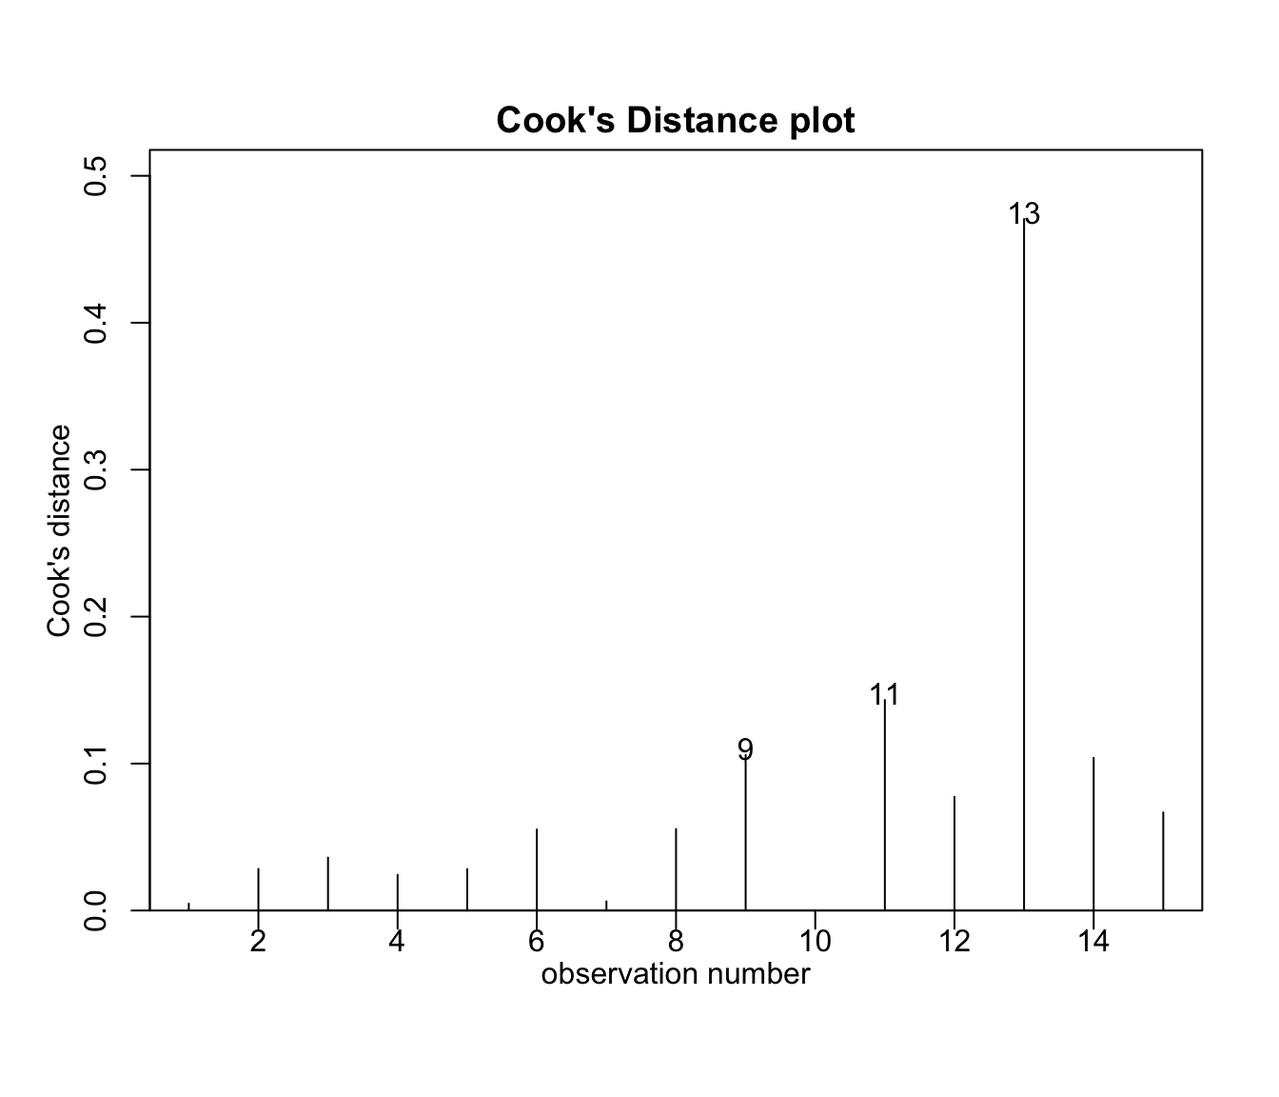
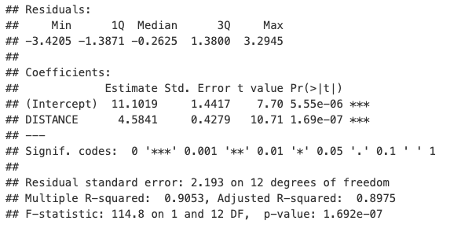
Second Analysis
MATH4753
04/30/2025
Cook’s Distance
Original (top) vs Modified (bottom)
Notes:
We will do a quick second analysis of the data just to see how to better fit the data. Here we use Cook’s distance to determine significant values and remove them. In the left plot, 13 is seen to be the most significant so we will remove that one and compare models. Here on the right side we have a summary of the original, which is on top, and the summary of the data without observation 13, and we can see that the residual standard error decreased, multiple R-squared increased, and coefficients shifted values. Based on this comparison we can conclude that the second model (removing one observation) is a better fit for the data.

Slide 16
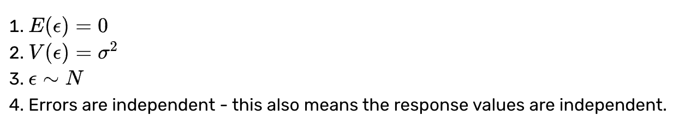
Satisfied Assumptions and Conclusion
MATH4753
04/30/2025
SLR Assumptions
Conclusion: YAY
Notes:
Just to reiterate everything in this presentation so far, we have successfully satisfied the assumptions necessary for Simple Linear Regression. The first one, we have successfully determined that the residuals have a mean of 0 during the theory analysis. The second one, we saw in the residuals vs fitted plot that the spread of residuals are roughly the same across all the fitted value levels. For the third one, we have determined that the residuals are normally distributed during the shapiro-wilks normality test. For the fourth one, as stated in the assignment it is hard to determine this without time series, but by thought process each item in the dataset is independent from one another, as one fire probably does not correlate to the other fire. Therefore we have satisfied the SLR assumptions.
We conclude that there IS a statistical significance between fire damage cost and fire distance from the fire station (even if the linear model is not the best fit). Our results show a clear positive correlation between the cost of the fire damage in thousands of dollars and the distance between a fire and a fire station in miles. Going forward, we can then use this statistical model to make predictions about the cost of fire damage based on its distance from the fire station. The addition of more data would increase the power of the statistical analysis but given what have, these results indicate that there is a linear relationship between these two variables.

Slide 17

Satisfied Assumptions and Conclusion
MATH4753
04/30/2025
Thank you!
Notes:
And here are my references! Thank you for watching.

